Slide 1
Cricket Analytics
Jasprit Bumrah Vs AB de Villiers

Slide 2
AB de Villiers Analysis Results
Runs Scored against Bumrah – 114
Balls faced of Bumrah – 79
Number of times ABD got out from Bumrah – 2
Strike Rate of ABD against Bumrah - 144.303

Slide 3
Bowlers Who got punished the most by ABD in terms of Strike Rate
bowler | runs_off_bat | ball | strike_rate
AD Russell | 87 | 38 | 228.947368
HH Pandya | 88 | 39 | 225.641026
JP Faulkner | 62 | 30 | 206.666667
CH Morris | 71 | 35 | 202.857143
SL Malinga | 124 | 64 | 193.75
Sandeep Sharma | 107 | 57 | 187.719298
SB Jakati | 55 | 30 | 183.333333
M Ashwin | 55 | 31 | 177.419355
PV Tambe | 54 | 32 | 168.75
B Kumar | 61 | 39 | 156.410256
DJ Bravo | 70 | 45 | 155.555556
IK Pathan | 67 | 44 | 152.272727
Shakib Al Hasan | 49 | 33 | 148.484848
JJ Bumrah | 114 | 79 | 144.303797
Imran Tahir | 58 | 41 | 141.463415
S Nadeem | 77 | 56 | 137.5
Harbhajan Singh | 110 | 81 | 135.802469
DS Kulkarni | 50 | 38 | 131.578947
SP Narine | 46 | 35 | 131.428571
RA Jadeja | 111 | 93 | 119.354839
PP Ojha | 39 | 33 | 118.181818
SK Warne | 43 | 38 | 113.157895
I Sharma | 37 | 34 | 108.823529
A Mishra | 40 | 37 | 108.108108
AR Patel | 70 | 65 | 107.692308
SR Watson | 53 | 50 | 106
R Ashwin | 59 | 56 | 105.357143
KH Pandya | 51 | 49 | 104.081633
PP Chawla | 53 | 52 | 101.923077
Rashid Khan | 38 | 39 | 97.435897
A Kumble | 39 | 41 | 95.121951
S Gopal | 30 | 34 | 88.235294
JH Kallis | 36 | 42 | 85.714286
Bowler with highest strike rate against ABD – AD Russell
Bowler with most runs against ABD – SL Malinga
Bowler with lowest strike rate against ABD – JH Kallis
Bowler with least runs against ABD – S Gopal

Slide 4
Scatter Plot Regions Description
Region of high runs and high strike rate(ABD’S Favourite bowler region) – Bowlers in this region are favourite to ABD as he can score more runs in less balls
Region of low runs and high strike rate - (ABD’S second Favourite bowler region) – these are Bowlers against whom ABD has scored less and balls faced are also less.
Region of high runs and low strike rate - (ABD’S second Favourite bowler region) --these are Bowlers against whom ABD has scored more and balls faced are a less.
Region of low runs and low strike rate - (ABD’S least Favourite bowler region) -- these are the bowlers against whom ABD struggles to make runs and maintain a strike rate above 100

Slide 5
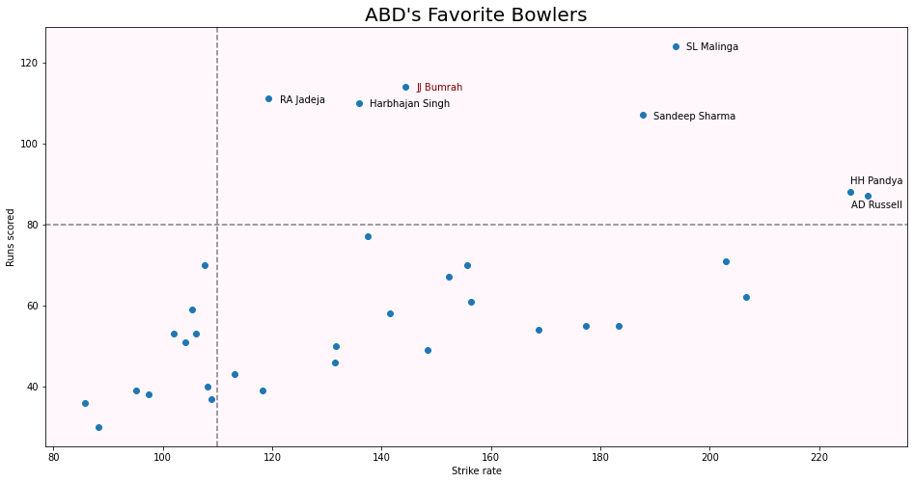
Region of high runs and low strike rate
Region of high runs and high strike rate
Region of low runs and low strike rate
Region of low runs and high strike rate

Slide 6
Hence according to plot ABD’S favourite bowlers are --
SL Malinga – (most runs)
Jasprit Bumrah
Ravindra Jadega
Harbhajan Singh
Sandeep Sharma
Hardik Pandaya
AD Russell –(highest strike rate)
Hence these are the bowlers against whom ABD’S performance in IPL is the best

Slide 7
Batsmen Against Bumrah with highest Strike rate
striker | runs_off_bat | ball | strike_rate
JP Duminy | 70 | 33 | 212.121212
F du Plessis | 58 | 34 | 170.588235
KD Karthik | 54 | 33 | 163.636364
SS Iyer | 52 | 35 | 148.571429
RV Uthappa | 52 | 36 | 144.444444
AB de Villiers | 114 | 79 | 144.303797
V Kohli | 115 | 81 | 141.975309
AT Rayudu | 48 | 34 | 141.176471
SK Raina | 50 | 39 | 128.205128
KL Rahul | 104 | 82 | 126.829268
AD Russell | 51 | 41 | 124.390244
S Dhawan | 95 | 77 | 123.376623
AM Rahane | 43 | 35 | 122.857143
SPD Smith | 60 | 52 | 115.384615
DA Warner | 54 | 47 | 114.893617
GJ Maxwell | 39 | 34 | 114.705882
JC Buttler | 37 | 33 | 112.121212
KM Jadhav | 41 | 37 | 110.810811
SV Samson | 48 | 46 | 104.347826
RR Pant | 36 | 37 | 97.297297
MS Dhoni | 56 | 58 | 96.551724
G Gambhir | 29 | 33 | 87.878788
WP Saha | 36 | 41 | 87.804878
SR Watson | 25 | 34 | 73.529412
CH Gayle | 37 | 53 | 69.811321
AR Patel | 21 | 32 | 65.625
Batsman with highest strike rate against Bumrah – JP Duminy
Batsman with highest runs against Bumrah – V Kohli
Batsman with lowest strike rate against Bumrah – AR Patel
Batsman with lowest runs against Bumrah -- AR Patel

Slide 8
Scatter Plot Regions Description
Region of high runs and high strike rate(Bumrah’s Least Favourite bowler region) – Batsmen in this region are least favourite to Bumrah as batsmen can score more runs in less balls.
Region of low runs and high strike rate - (Bumrah’s second least Favourite bowler region) – Bumrah can tolerate the batsmen as they make less runs against him.
Region of high runs and low strike rate - (Bumrah’s second least Favourite bowler region) -- Bumrah can tolerate these batsmen too as they low strike rate against him(These batsmen have higher chances of hitting boundaries and rotating strike).
Region of low runs and low strike rate - (Bumrah’s most Favourite bowler region) -- these are the batsmen who struggles to play against spell of Bumrah.

Slide 9
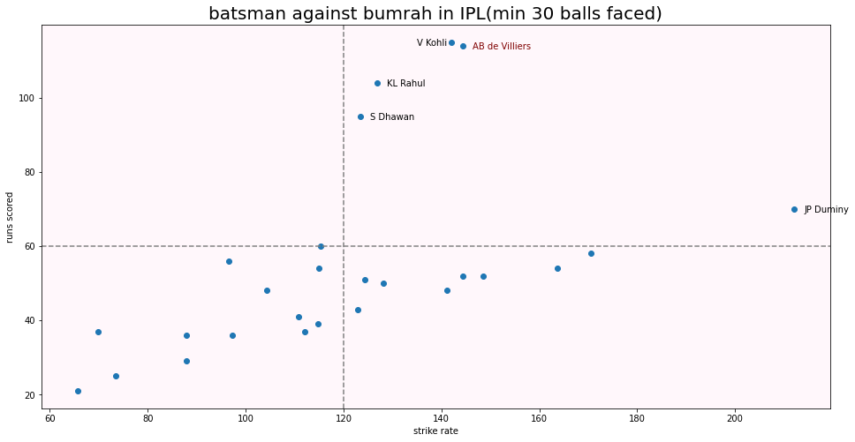
Region of high runs and high strike rate
Region of high runs and low strike rate
Region of low runs and low strike rate
Region of low runs and high strike rate

Slide 10
Hence according to plot top batsmen against Bumrah are --
Virat Kohli – (most runs)
AB de Villiers
KL Rahul
Shikhar Dhawan
JP Duminy –(highest strike rate)

